Slide 1
Site Strategy Case Studies
Group 01 – “Pixel”
Davide Monticelli - Federico Fauli - Yafim Simanovsky

Slide 2
Pig City – MVDRV a theoretical program

Slide 3
Facts
- 80 Billion kg of pig consumed in 2000
- Diseases cause damage in production
(Swine Fever and Foot and Mouth disease)
- In 1999, 15.2 million pigs and 15.5 million humans officially Inhabited the Netherlands.
1 = 664 m2

Slide 4
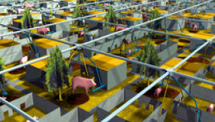
PROBLEM
Is it possible to compact all the pig production within
concentrated farms, avoiding unnecessary transportation and
distribution, and reducing diseases?
Consumer
Food
Space

Slide 5
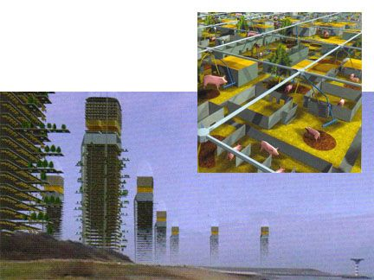
SOLUTION
The solution was to put all the
elements together in skyscrapers,
saving on transportation and
Production waste.
Bringing into one space both
the product and its process
(food for animals and animals
themselves) and this saves on
energy in every field and
CO2 emissions.

Slide 7
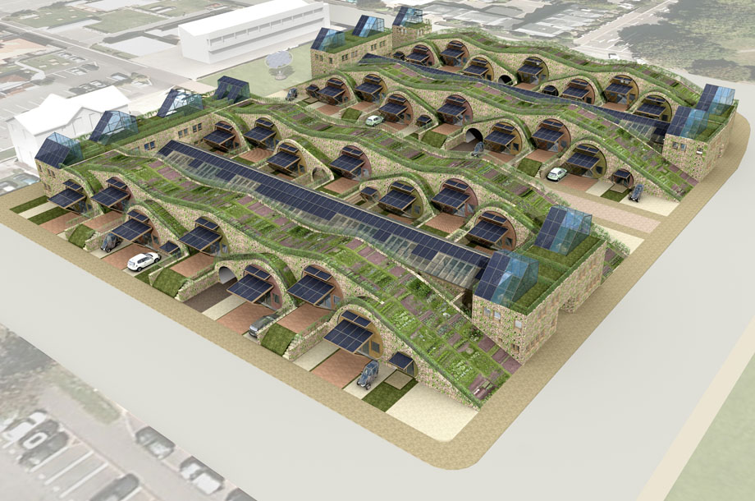
ZedFactory Christchurch Urban Village (community strategy project)

Slide 8
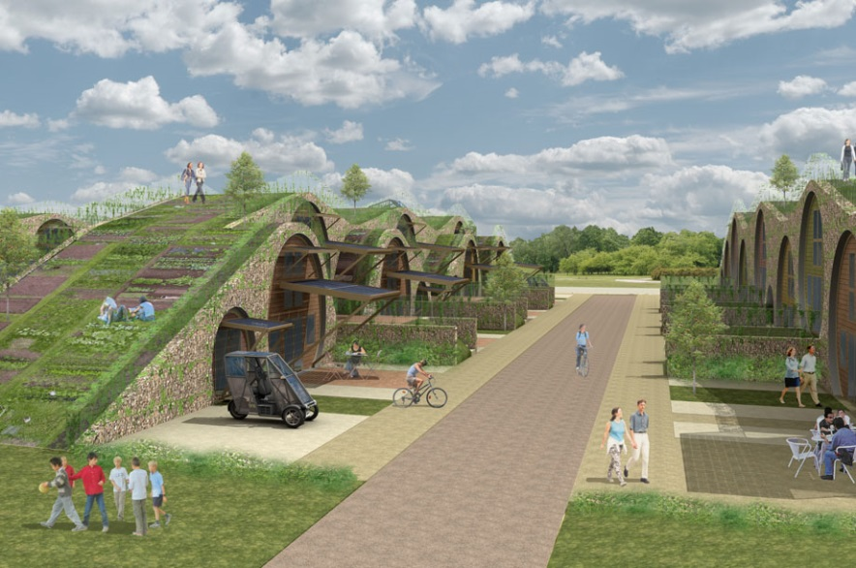
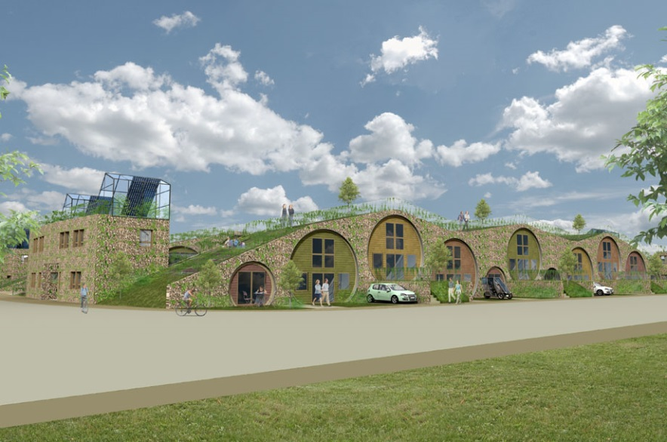
URBAN VILLAGE CONCEPT
The new urban village will nestle into
the heart of the city.
It will be located near an existing
residential area.
This is a chance to influence
how a new city develops and
grows by designing an
exemplar housing
development that will be the
catalyst for modern urban
living in the heart of the city.

Slide 9
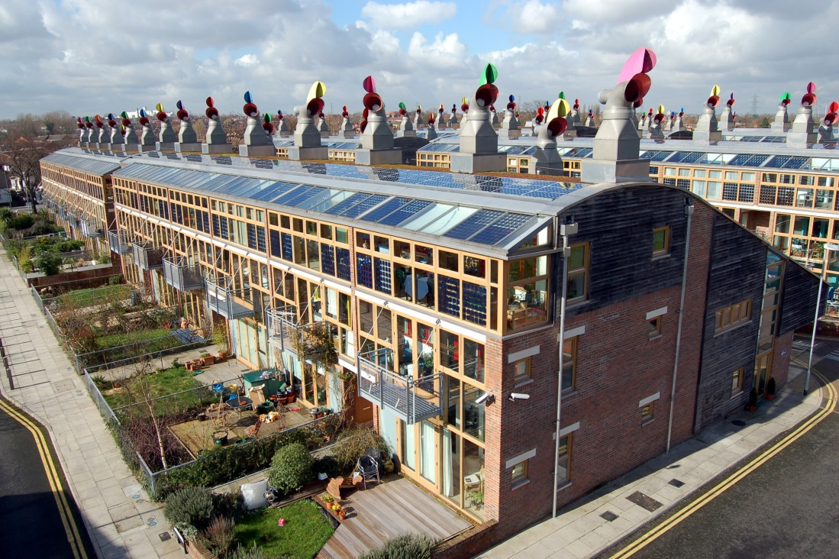
ZedFactory – BedZED (Bill Dunster Architects) (built)
An environmentally friendly housing development in Hackbridge, London.
82 homes, and 1,405 m2 of work space
were built in 2000–2002.
The project is designed to use only energy from renewable sources generated on site.

Slide 10
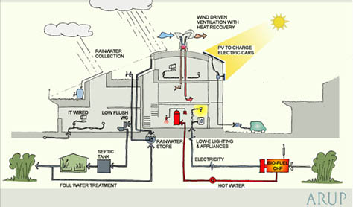
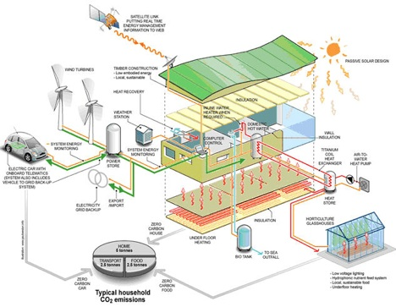
Principles:
Zero energy— designed to use only energy from
renewable sources generated on site.
777m2 of solar panels.
Energy efficient— houses face south to take advantage of solar gain, are triple glazed, and have high thermal insulation.
Water efficient— most rain water falling
On the site is collected and reused.
Low-impact materials— building materials were selected from renewable or recycled sources within 56 km of the site, to minimize the energy required for transportation

Slide 11
Results (2003 in comparison with UK):
- Space-heating requirements were 88% less
- Hot-water consumption was 57% less
- The electrical power used, at 3 kilowatt hours per person per day, was 25%
less than the UK average; 11% of this was produced by solar panels.
- Mains-water consumption has been reduced by 50%.
- The residents' car mileage is 65% less.
- the biomass wood chip boiler (biomass gasifier) didn’t work as planned
- the passive heating from the sunspaces had been insufficient for comfort in winter and created overheating in summer
- Embodied footprint was large. 67.5 tonnes CO2e for a 100m2 flat.
Cons:

Slide 12
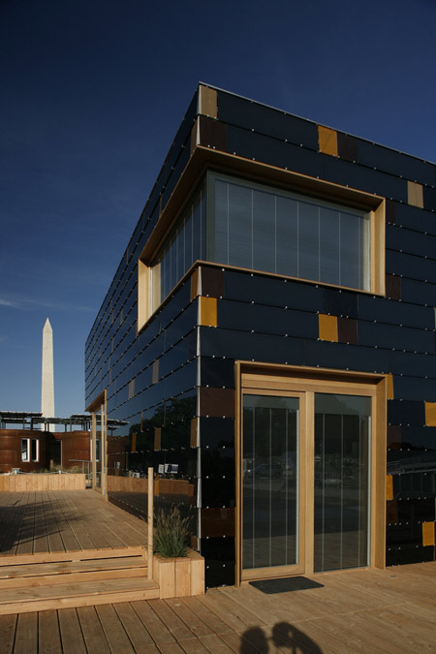
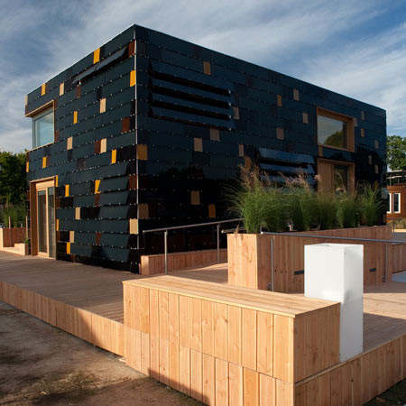
Technische Universitat Darmstadt Solar Powered House (built – student competition)
2 story, cube-shaped house, with a facade and roof clad in 2 types of solar cells, which will produce 200% of the home’s energy.
It is highly insulated and has automated louvre window shades to reduce unwanted heat-gain.
It shows the practical application
of BIPV (building integrated
photovoltaic) on a small scaled
housing.

Slide 13
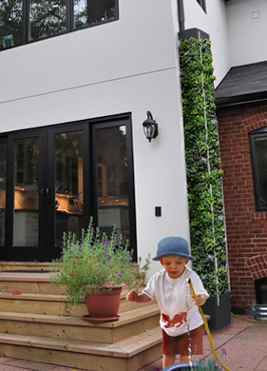
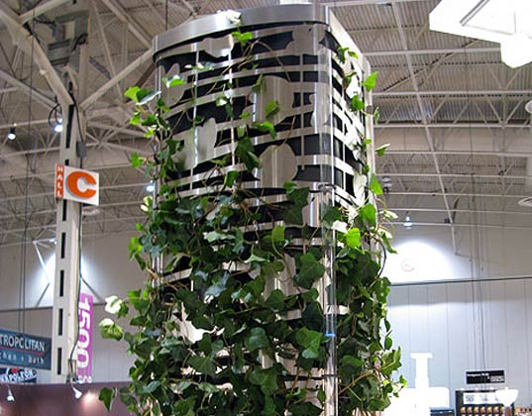
MOSS SUND Architects CISTA: Modern Rainwater Harvesting Made Beautiful

Slide 14
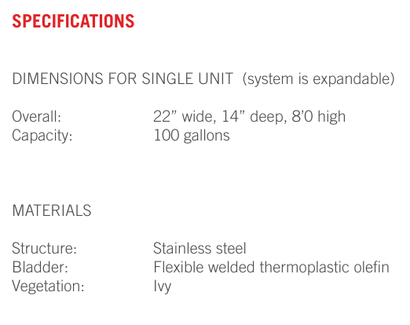
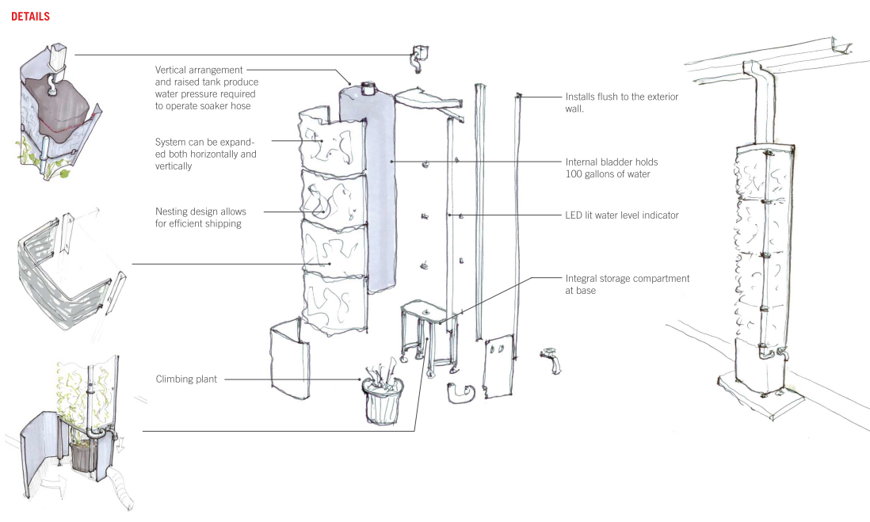
CISTA is a rain water harvesting system designed for urban environments. It provides storage for rain water within a vertical planted frame, allowing us to conserve water and increase green space
An LED float in a tube is anchored to the side to give an indication of water level, and a metered drip from the tank continuously waters the plant.

Slide 15
Bibliography
Pig City:
Design Team : Winy Maas, Jacob van Rijs and Nathalie de Vries, Ronald Wall, Arjan Harbers,
Cord Siegel, Anton van Hoorn, Christoph Schindler, Katarzyna Glazewska and Uli Queisser.
http://www.mvrdv.nl/projects/181_pig_city/#
Pig City video: The Why Factory (MVDRV collaboration)
http://www.youtube.com/watch?v=x1r5GutrXX4
ZedFactory Christchurch Urban Village:
http://www.zedfactory.com/zed/?q=node/165
ZedFactory – BedZed:
http://en.wikipedia.org/wiki/BedZED
Technische Universität Darmstadt Solar House:
http://www.dezeen.com/2009/10/16/solar-decathlon-house-by-technische-universitat-darmstadt/
CISTA rainwater system:
http://www.mosssund.com/CIST.html
http://mosssund.typepad.com/files/cista-info-package.pdf
http://www.fig40.com/work/cista-rain-harvesting-system/

