Slide 1
Hydroponics
Growing plants in water, without soil
ZEim:
De Pascalis Martina
Nedevska Maria-Yoana
Masserini Davide

Slide 2
What is hydroponics?
Hydroponics is a subset of hydroculture and is a method of growing plants using mineral nutrient solutions, in water, without soil.

Slide 3
Origins
The earliest published work on growing terrestrial plants without soil was the 1627 book Sylva Sylvarum by Francis Bacon
After several discoveries of German botanists in the years 1859-65, growth of terrestrial plants without soil in mineral nutrient solutions was called solution culture.
By analogy with the ancient Greek term for agriculture, geoponics, the science of cultivating the earth, William Gericke of the University of California coined the term hydroponics in 1937.

Slide 4
Success of hydroponics

Slide 5
Why hydroponics?
Yield 2 to 10 times more than soil
Nutrition no deficiencies or toxicities
Water 1/10th that of irrigation
Diseases no soil bacteria or viruses
Weeds virtually none
Quality higher, better, healthier
Costs initially higher, then lower
Maturity non-seasonal, faster
Transplanting minimal problems
Environmental compatible, safe

Slide 6
Typologies
There are six different types of hydroponic growing systems, they are:
Aeroponic System
Drip System
Ebb and Flow System
N.F.T.
Water Culture System
Wick System

Slide 7
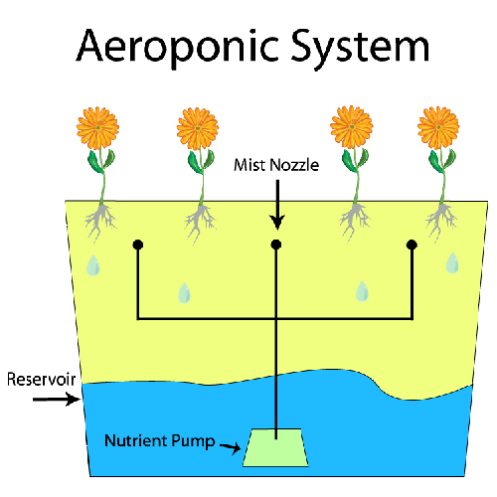
Aeroponic system
The growing medium is primarily air
The roots hang in the air and are misted with nutrients every few minutes
A timer must be used to control the nutrient pump to ensure the plants are properly misted with the nutrients

Slide 8
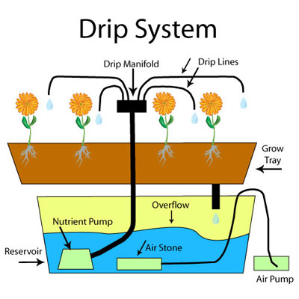
Drip system
Plants are in rock-wool cube, then grow on in a rock-wool slab
Plants individually fed using drippers which deliver a volume of water per hour
Recovery Drip system collects and reuses solution in excess
Non-Recovery Drip system must ensure the least amount of waste

Slide 9
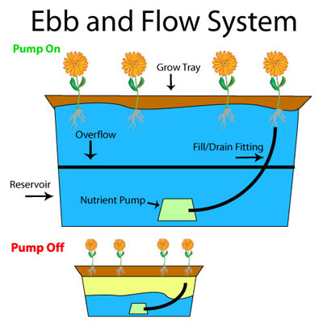
Ebb and Flow system
This system works by temporarily flooding the grow tray with nutrient solution and then draining the solution back into the reservoir, which is controlled by a submeresed pump on a timer
This system can be modified in many ways such as filling the grow tray with grow rocks or gravel

Slide 10
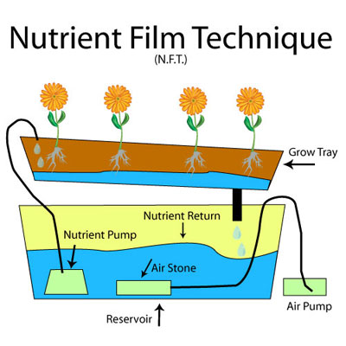
Nutrient Film Technique system
Plants supported in small plastic baskets on an inclined table
Nutrient enriched water flows over the roots (1-3mm)
Water returns to the reservoir

Slide 11
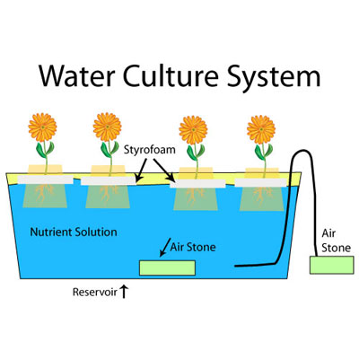
Deep Water Culture system
A Styrofoam platform typically holds the plants and floats on the nutrient soltuion
An air pump is used to supply air to a bubbling stone that releases the nutrient solution and supplies oxygen to the plant roots
Leaf lettuce is the predominant plant grown in this type of system, very few other plants grow well in the Water Culture System

Slide 12
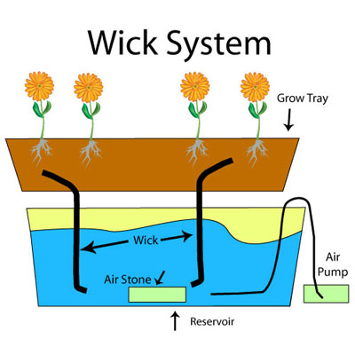
Wick system
The Wick System is a passing system, meaning it has no moving parts
The nutrient solution is released into the grow tray through a wick
There are several different growing mediums that can be used in this hydroponic system

Slide 13
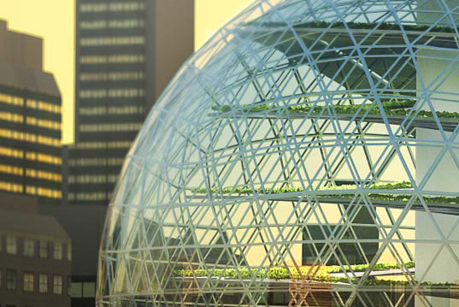
Hydroponics in architecture (1)
Architects: Plantagon
location: Linkoping, Sweden year: under development

Slide 14
Hydroponics in architecture (2)
Architects: R&Sie(n) key dimension:130sqm
location: Paris, France year: 2008

Slide 15
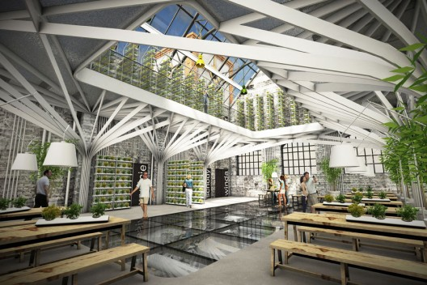
Hydroponics in architecture (3)
Architects: mode:lina Area: 420sqm
location: Pila, Poland Phase: concept

Slide 16
Hydroponics functional diagram

Slide 17
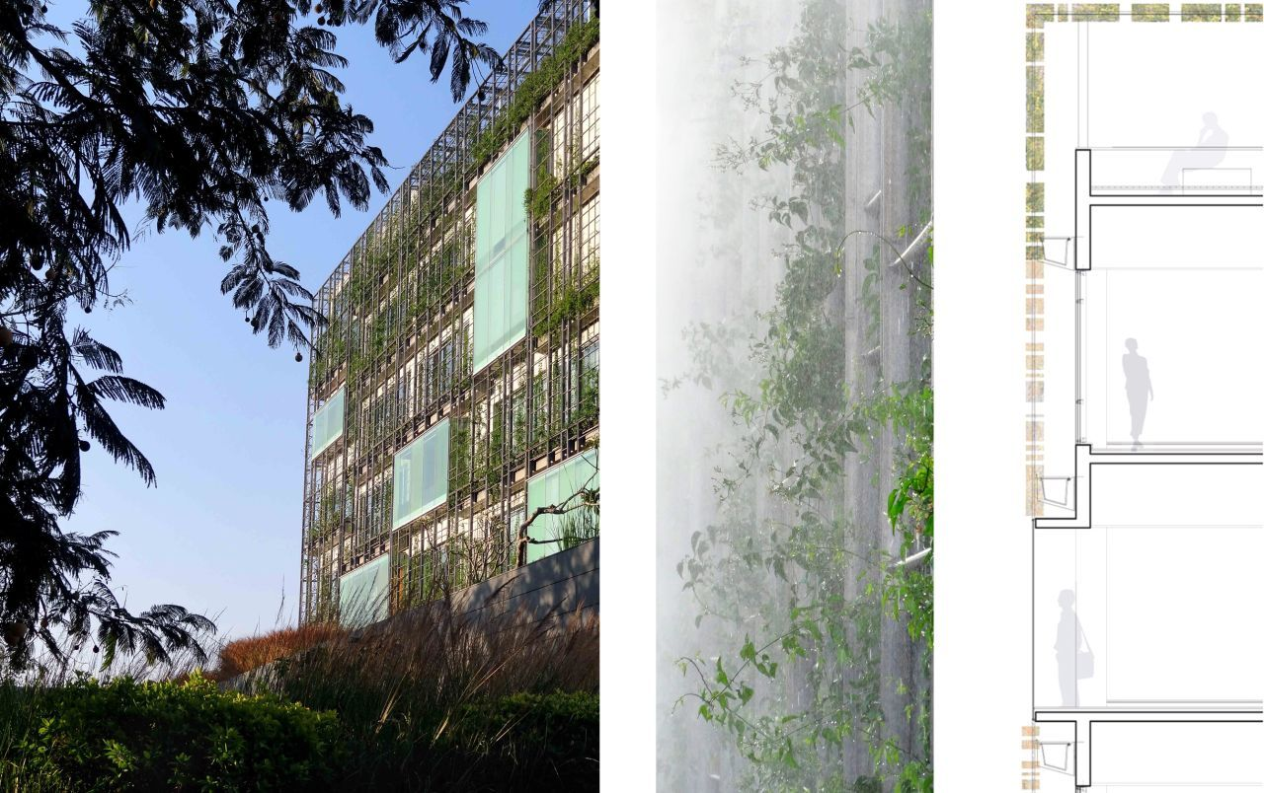
Hydroponics in architecture (4)
Architects: RMA architects Year: 2012
location: Cyber City, Hyderabad, India

