Slide 1
Aquaculture system
Cherie lulu shimris| cataliana puello|
uzi rabia| ozge tektas | Group no.16

Slide 2
Recirculating Aquaculture Systems
Recirculating aquaculture systems are systems in which aquatic organisms are cultured in water which is serially reconditioned and reused.
WHY?
Conserves water
Permits high density culture in locations where space and or water are limiting
Minimizes volume of effluent, facilitating waste recovery
Allows for increased control over the culture environment, especially indoors
Improved biosecurity
Environmentally sustainable

Slide 3
GENERAL IDEA

Slide 5
Culture Tank Effluent
High concentrations of suspended
and dissolved solids
High ammonia levels
High concentration of CO₂
Low levels of dissolved oxygen

Slide 6
SYSTEM COMPONENTS
AERIATION & OXYGENATION
SOLID CAPTURE
WASTE MANAGEMENT
FINE & DISSOLVED SOLID REMOVALS
DISINFECTION & STERALIZATION
CO2 REMOVAL
HYDRAULICS

Slide 7
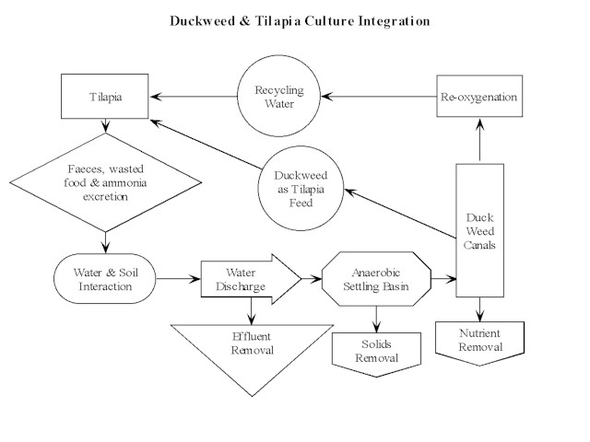

Slide 8
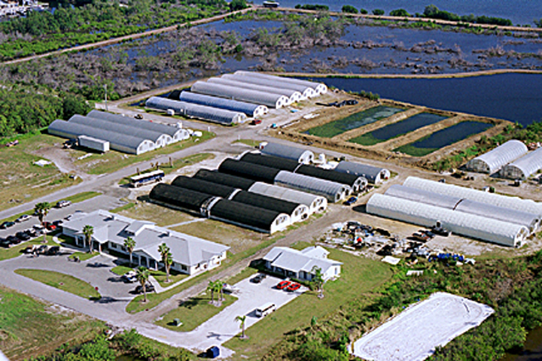
Classification of culture systems
Temperature Salinity
Impacts the rates of chemical and biological
process at the most fundamental level
Affects: bacterial growth,
respiration, nitrification efficiency
Cool-water species: below 20º C
Warm-water species: above 20º C
Affects the oxygen saturation level

Slide 9
LEVEL OF NUTRIENT ENRICHMENTS
OLIGOTROPHIC
Excellent water quality
Very Clear
Used in display aquaria
Most frequently used for breeding purposes
Some species are kept in these conditions all of their lives, while others for a period of time
MESOTROPHIC
Some deterioration in aesthetics
Water quality at safe levels
Dissolved Oxygen- above 5 mg/L
TAN & Nitrite – less than 1mg-N/L
Total suspended solids – less than 15 mg/L
EUTROPHIC
Dissolved oxygen levels- economic optimum level
Ammonia & Nitrite – less than 2mg-N/L
Water quality – marginal
Species evolved under similar natural conditions prosper in these conditions

Slide 10
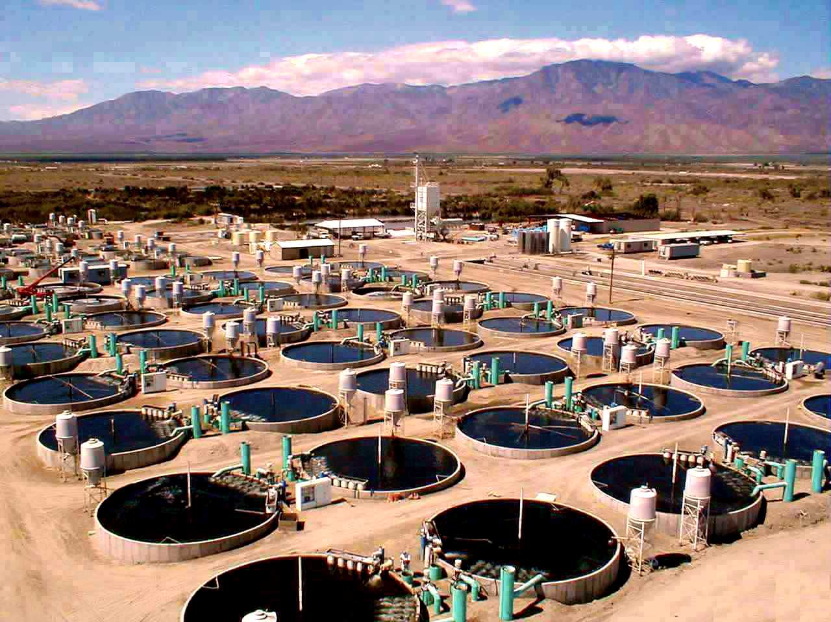
INTEGRATED SYSTEM
An assembly of components that creates an artificial environment suitable for production, breeding or display of aquatic animals

Slide 11
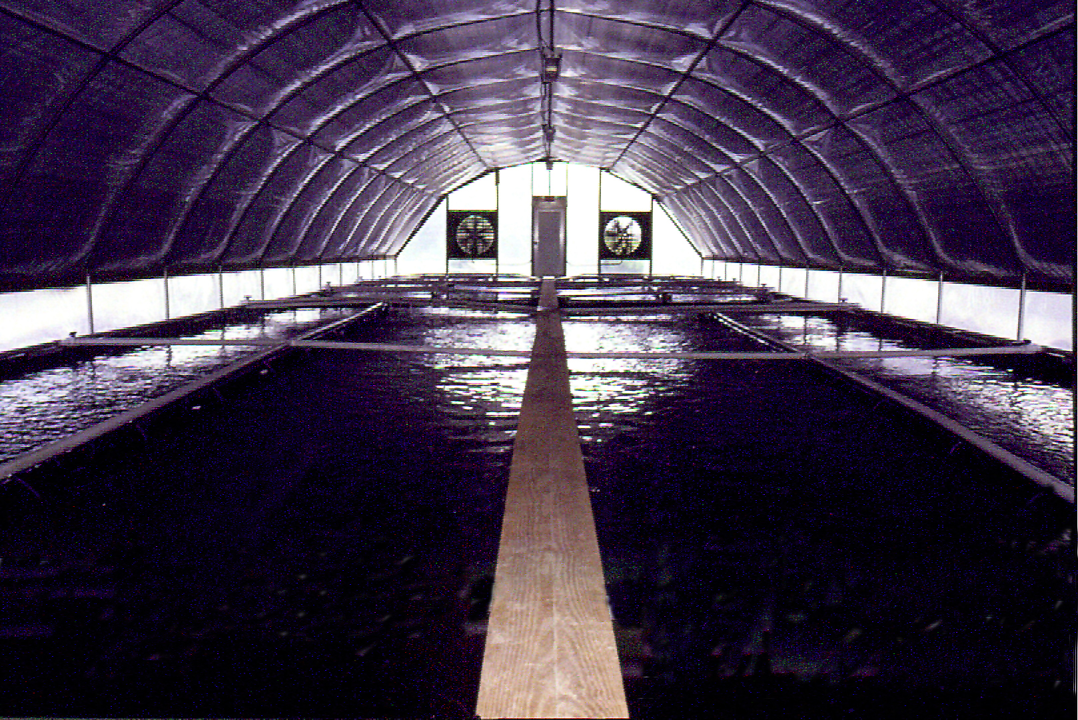
INDOOR SYSTEM

